Slide 1

Crowd-Robot Interaction:
Crowd-aware Robot Navigation with Attention-based Deep Reinforcement Learning
MAE 547 Project1
By,
Cherupally Surya Kiran
ASU ID 1223453127
Guided By,
Prof. Hyunglae Lee

Slide 2
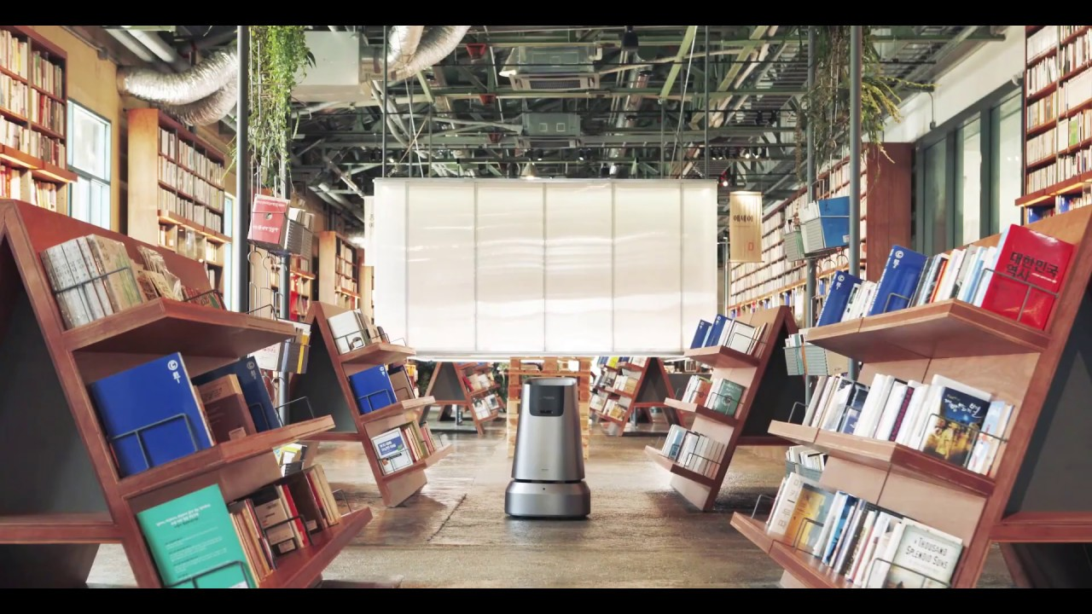
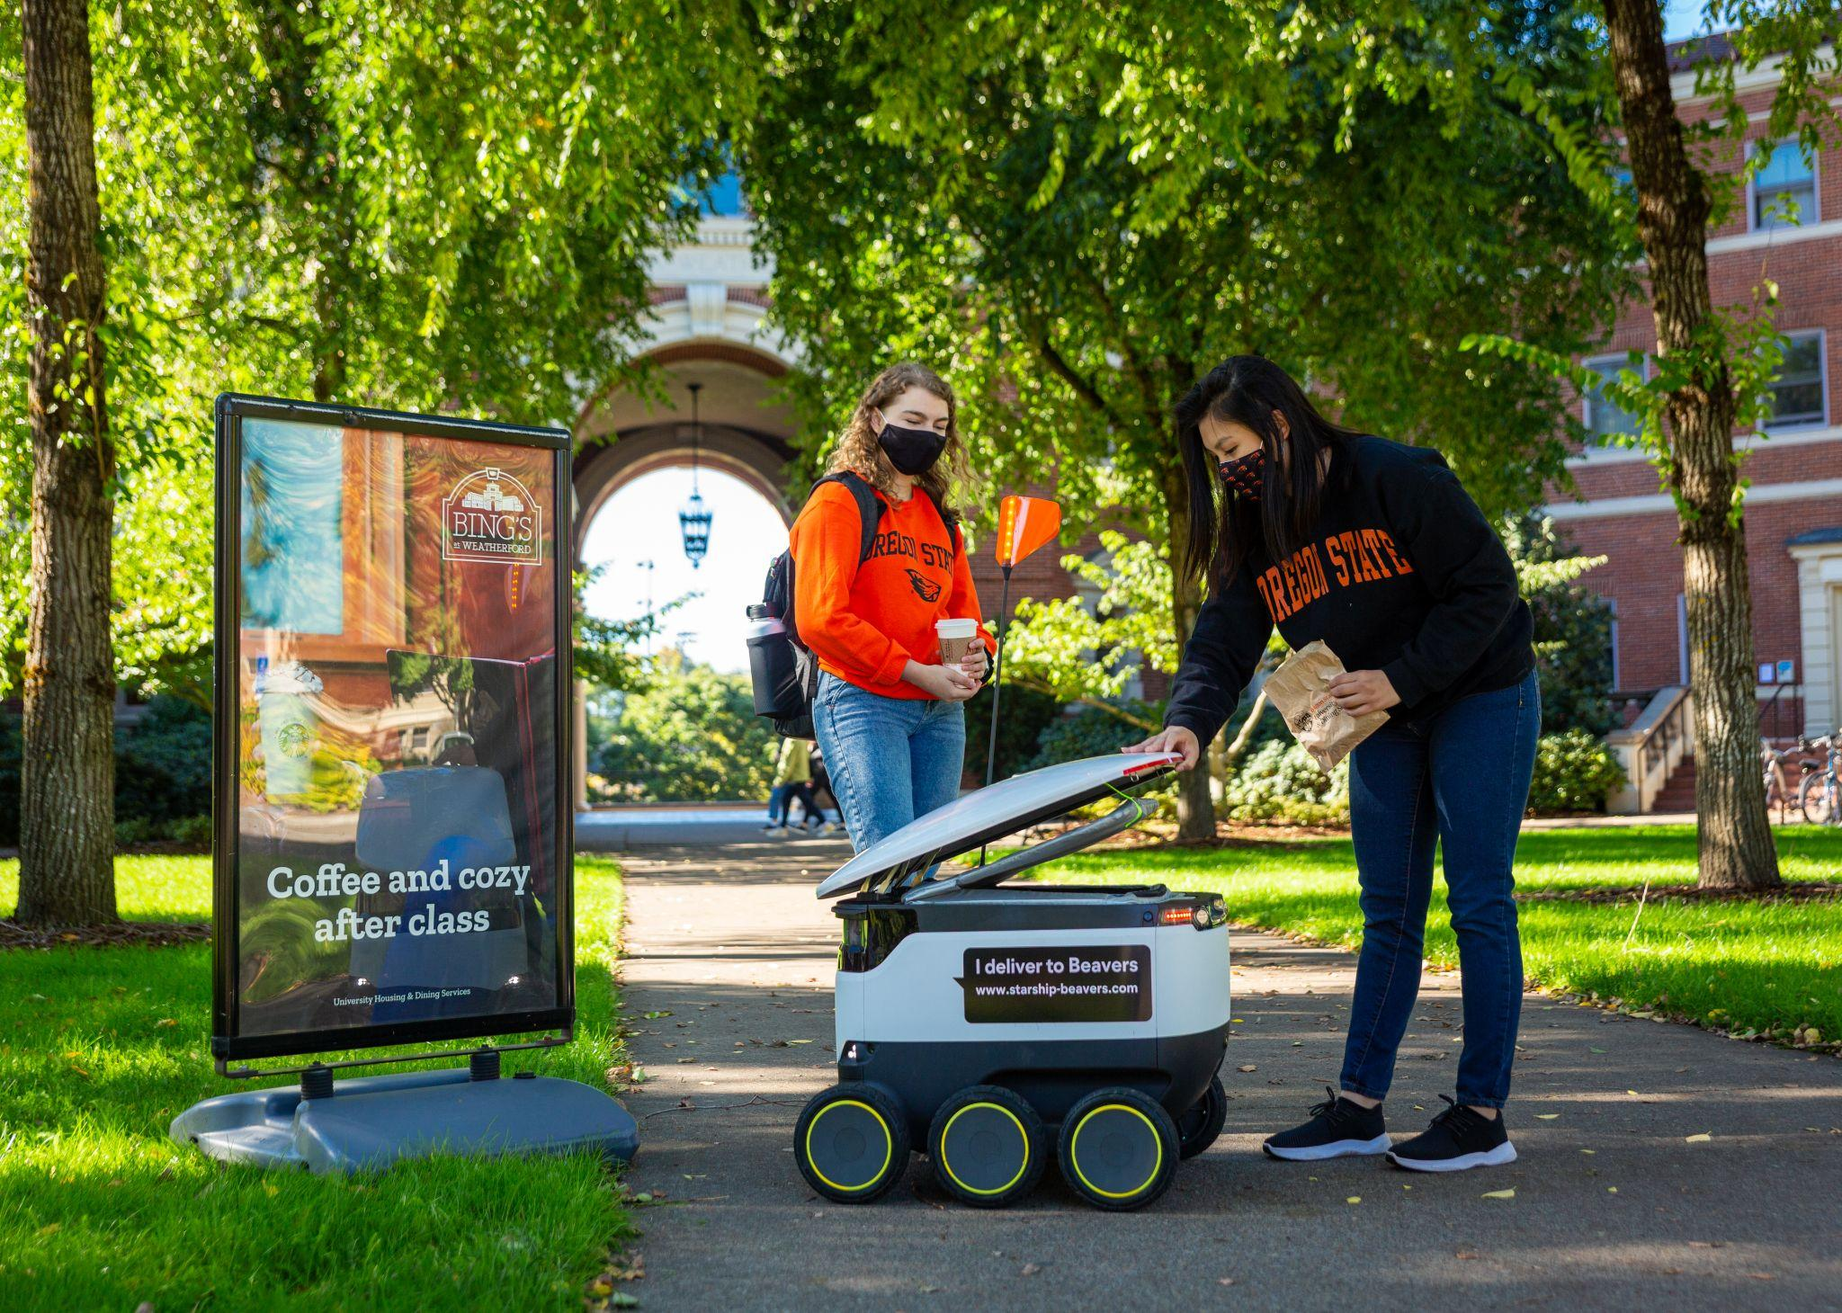
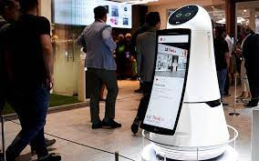
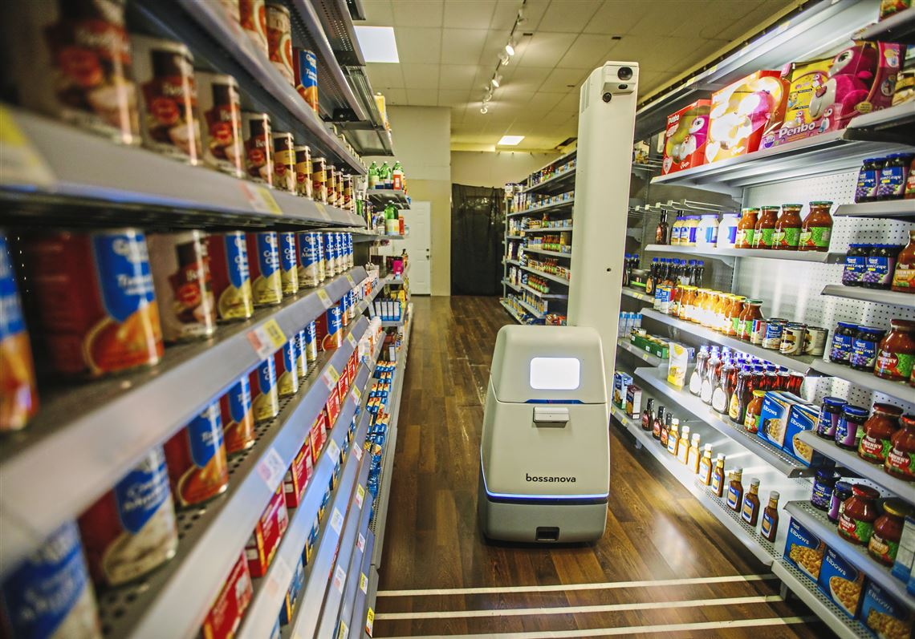
INTRODUCTION
With the rapid growth of machine intelligence, robots are envisioned to expand habitats from isolated environments to social space shared with humans.
NAVER ( Library)
STARSHIP (University)
LG CLOI (Airport)
NOVA ( Walmart)

Slide 3
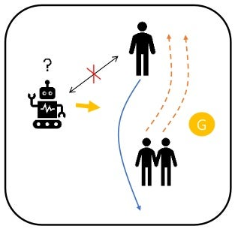
CHALLENGES IN CROWD ENVIRONMENT
Dynamic, dense moving obstacles ( pedestrian)
Non communicating situation.
Agent can’t realize the intent of other moving agents
How to reach the goal with time-efficiently?
How to move social-compliantly?
Collision avoidance
Pedestrian should feel comfortable

Slide 4
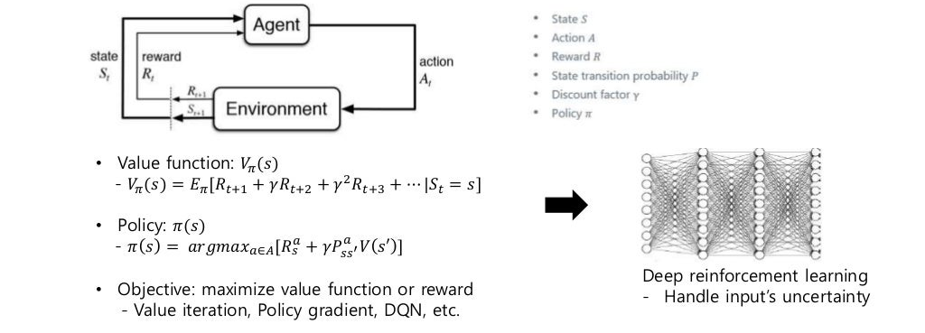
Deep Reinforcement Learning

Slide 5
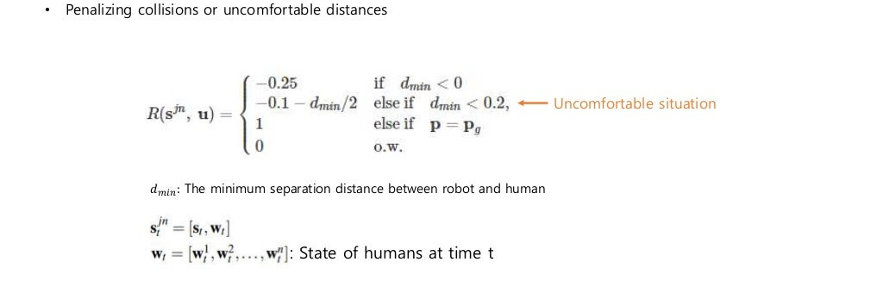
Reward Function

Slide 6
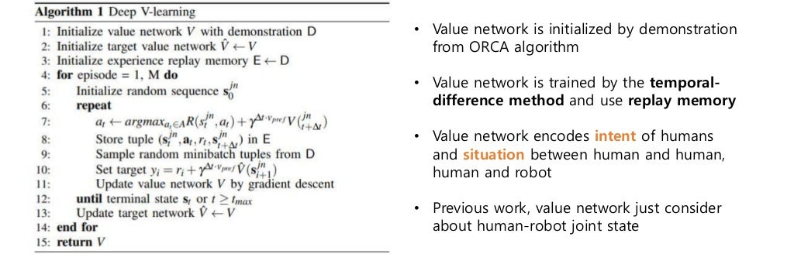
Sequential decision - making problem

Slide 7
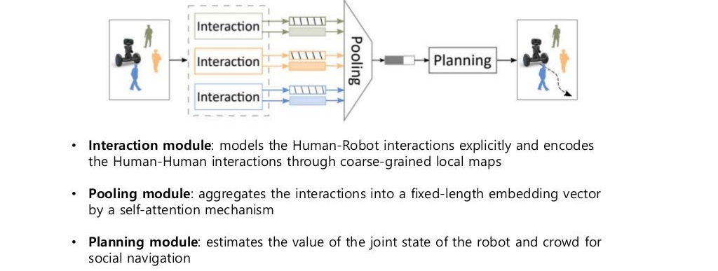
Framework

Slide 8
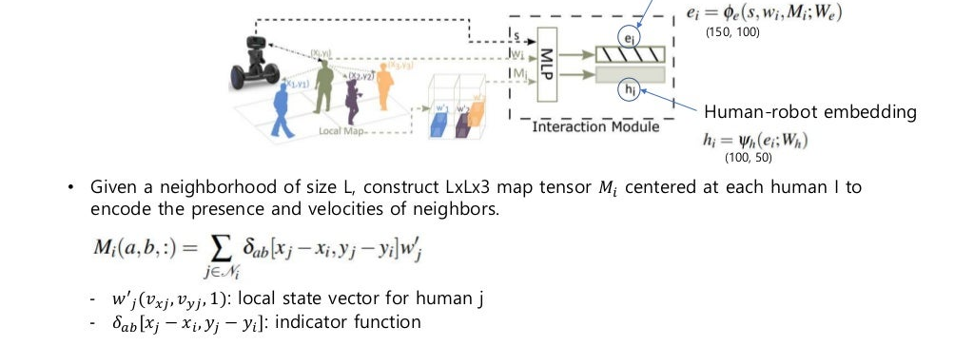
Interaction module

Slide 9
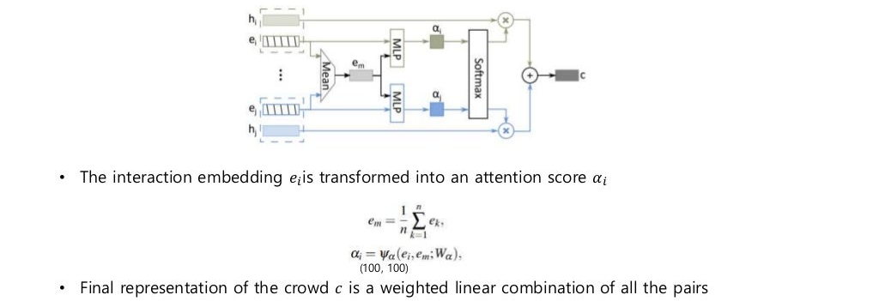
Pooling module

Slide 10
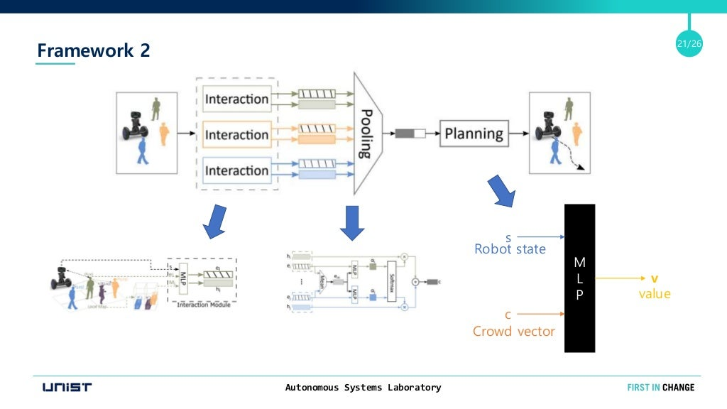
Complete Flow

Slide 11
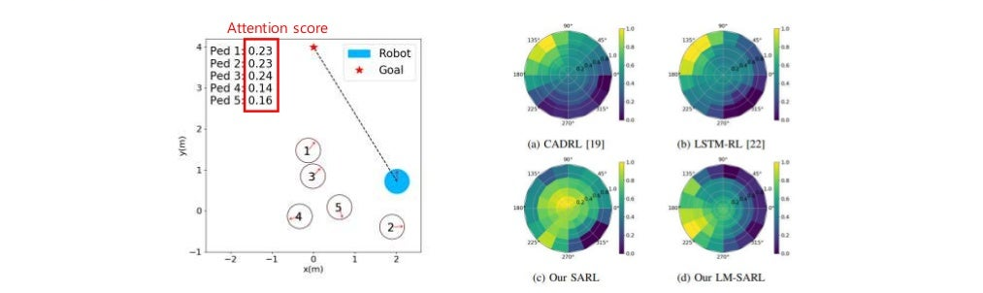
RESULTS
The baseline methods predict high values for high speeds towards the goal, which is dangerous.
In contrast, SARL slows down and waits safely
LM-SARL prefers to turn to 200◦ , preparing to pass behind them.
LM-SARL assigns low importance scores to human #4 and #5 who walk away
Highest weight to #3 who is most likely to get close soon.
Attention scores in a dense scene.
Value estimations by different methods for the dense scene

Slide 12
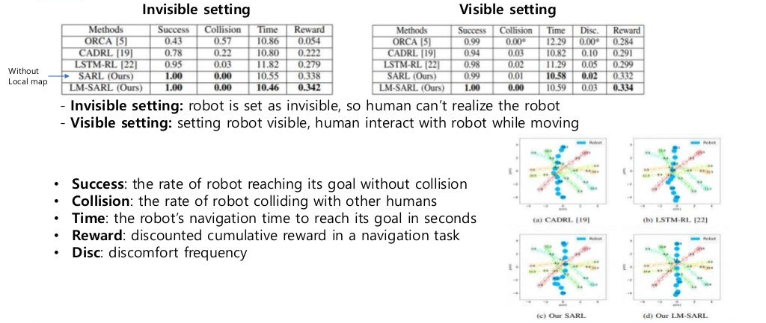

Slide 13
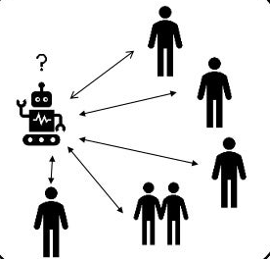
DISCUSSION & CONCLUSION
Decomposing the Crowd-Robot Interaction into two parts.
Jointly model the Human-Robot and Human-Human interactions
Aggregate the interactions into a compact crowd representation via a self-attention model.
Outperforms state-of-the-art navigation methods in terms of time-efficiency and task accomplishments.
Demonstration of model’s ability to reason the importance of humans in a crowd.

Slide 14
CRITICS (Takeaways from this work)
Deep reinforcement learning approaches have recently been proved to be effective in learning socially cooperative policies.
When the crowd becomes larger, their capacity to cooperate deteriorates because they often relax the situation as a one-way Human-Robot interaction problem.
This work, goes beyond first-order Human-Robot interaction.
This model captures the Human-Human interactions occurring in dense crowds
Their attentive pooling mechanism learns the collective importance of neighboring humans with respect to their future states.
Understand about spatial and temporal relationships for robot decision making in crowd navigation.

Slide 15
CRITICS (Future scope)
As opposed to most simulation-based approaches where agent behaviors are generated from crowd simulation, human behaviors grounded in real-world datasets are needed.
Consider different set of evaluation metrics :
  measure path (e.g., path irregularity, navigation efficiency)
  motion (e.g., average speed and energy)
  quality(e.g.,naturalness; discomfort;sociability)
  safety (e.g., closest collision distance)
  success rate
Understand situation and make latent space by encoder network for decision making methods.
Consider different scenarios:
  Following, leading, and accompanying
  Overtaking
  Approaching
  Crossing
  Passing.
Consider Diverse, Dynamic Human Models and Long-Term Effects
Evaluating Mobile Robots of Different Forms

Slide 16
Thank You

