Slide 1

SES-598 AUTONOMOUS EXPLORATION SYSTEMS
PAPER PRESENTATION
Local path planning in a complex environment for self-driving car
Unghui Lee; Sangyol Yoon; HyunChul Shim; Pascal Vasseur
Presented By
Satya Shreya Sri Reddy
ASU ID 1223453127
Guided By
Prof. Jnaneshwar Das
https://ieeexplore.ieee.org/document/6917505

Slide 2
{
Introduction
System Overview
Path Representation
Path Planning
Results
Conclusion
OUTLINE

Slide 3
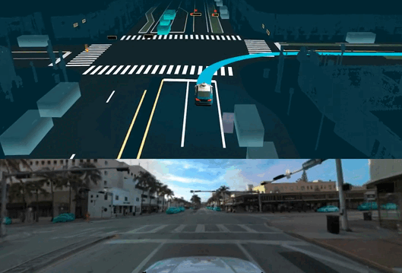
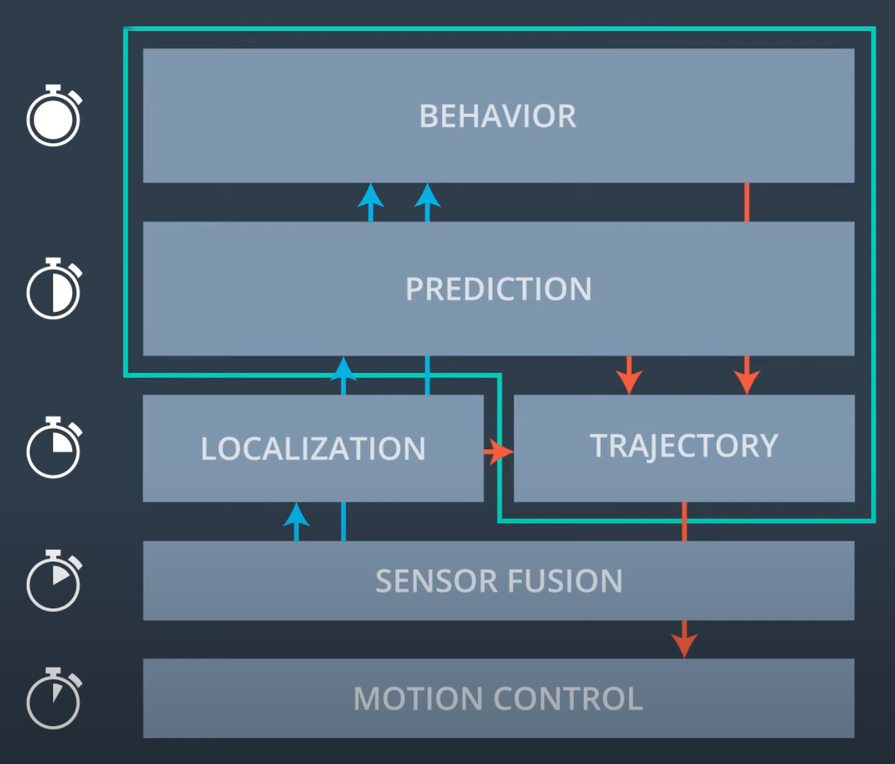
Introduction
A driver assistance system is developed to assist driver’s safety such as lane keeping , automatic parking, and front vehicle collision prevention.
The DARPA established the Grand Challenge where unmanned vehicles run the desert autonomously
A self-driving car performs path planning and obstacle avoidance utilizing the surrounding environment information
Path planning determines vehicle's behavior.
Global path planning drives car according to the preset path information and current position of a car.
Local path planning responds to signals from sensors regarding the surrounding environment while considering dynamics, kinematics and other constraints of the car.

Slide 4
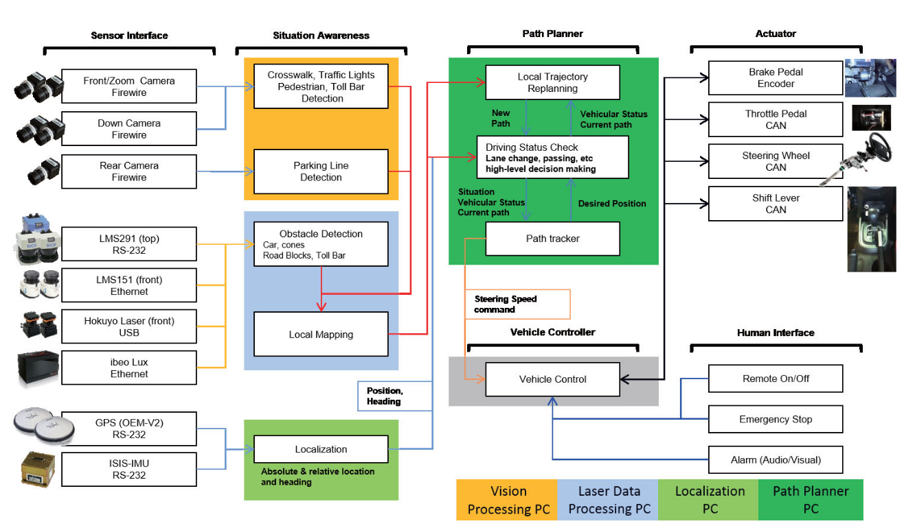
Deeper Look into System Overview

Slide 5
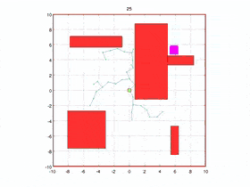
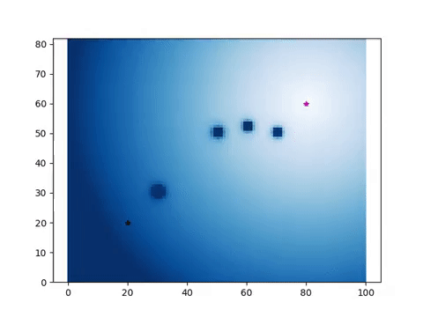
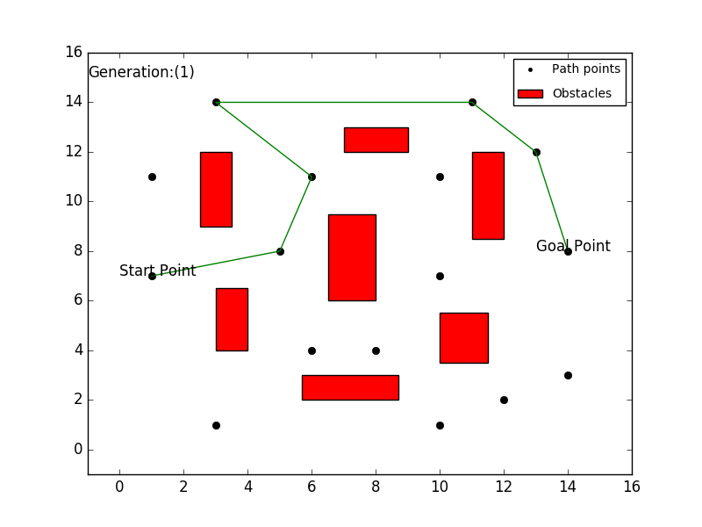
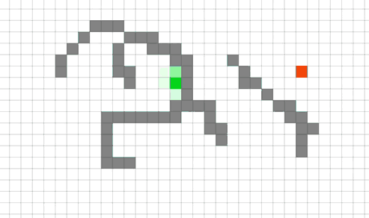
Planning Overview
Path planning, can be categorized into:
  Potential-field approach
  Roadmap based approach
  Cell decomposition based.
Cell decomposition is dependent on cell’s type and size. Not suitable for path planning for high speed driving.
RRT algorithm in real time, high computing is required
A new path representation method using Voronoi Cells and a method of collision detection with path representation are proposed .
Fig1. RRT
Fig2. Potential-Field
Fig3. Genetic Algorithm
Fig4. A star
Notes:
Fig 1 : RRT* path planning
Fig2 : Potential-field path planning
Fig3: Genetic path planner
Fig4: A* path planner

Slide 6
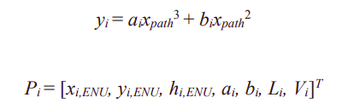

Path Representation
Way points are inappropriate representations for continuous collision checking along the path and modification for avoidance
Continuous path using polynomials and presented vehicle control using existing way point tracking algorithm.
A i-th path can be expressed simply by an array, which reduces the size of the array significantly compared to defining it by way points and can be used for search of existence of collision or new path generation conveniently.
*xi,ENU, yi,ENU and hi,ENU represent starting position and azimuth of path
*Li and Vi represent a length of path and maximum speed of corresponding path.

Slide 7
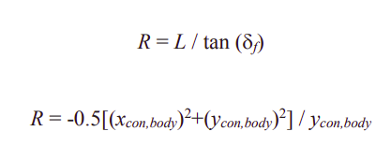
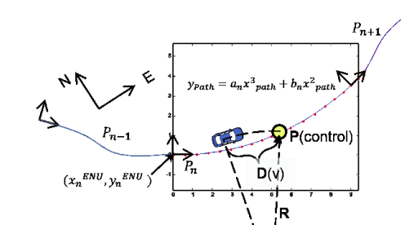
Path Tracking
Assumptions:
The right and left wheels as one to control lateral direction of a vehicle.
No slip between wheels and surface
Induction of the rotation radius of a vehicle into the central axis of the rear wheel in a vehicle using kinematics has been presented.
To track the path, one control point is designated to a position where D (V) is variably changed according to the vehicle speed in the front side of the driving direction .
A control point Xcon over the path can be transformed into a body coordinate system via coordinate transformation.
Relationship between rotation radius of a vehicle and control point in the body coordinate system.

Slide 8
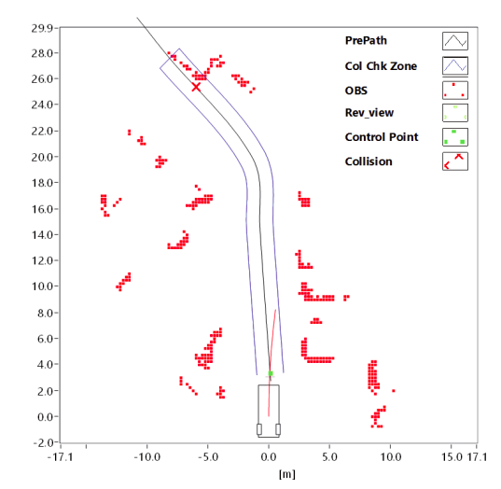
Path Planning
Collision Detection
Algorithm divided into 2 parts:
Detection from vehicle position to the control point
For preparing the speed profile for vehicle’s deceleration and emergency stop.
This detection determines existence of obstacles over the trajectory generated according to the rotation radius of a vehicle between current vehicle position and the control point.
Detection from the control point to the sensing area.
Existence of obstacles by extending the path to the right and left side to create a collision detection boundary.
The collision can be detected by the cubic formula of the right and left boundary contain the obstacle points.
If collision exists, the path generation algorithm for collision avoidance is executed to avoid the obstacle.

Slide 9
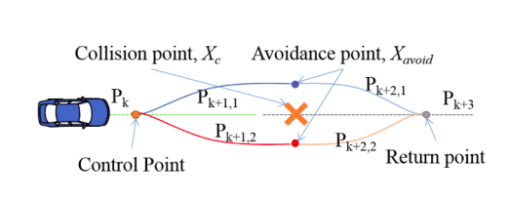
Path generation using cubic polynomials
To get a new path using the cubic polynomials, a position and slope of two regions are required.
Collision detection algorithm, avoids the detected collision point and generates an avoidance path by setting a path from the control point to the avoidance point to prevent collisions.
Setting a path from the avoidance point to the return point over the originally set path.
The control and return points are selected from the existing path while the avoidance point is an arbitrary point for avoidance maneuver against obstacles.
This point should be capable of generating two homotopic paths which offer the possibility of detouring the collision point.
The avoidance point was obtained by using the Voronoi cell-based algorithm.
An avoidance path is generated using the cubic formula thereby verifying whether no collision is expected by using the avoidance path generated by the collision detection algorithm and finally modifying a path that has no collision.
If all the avoidance paths are blocked, a new path is searched using VFH (Vector Field Histogram) while driving reversely

Slide 10
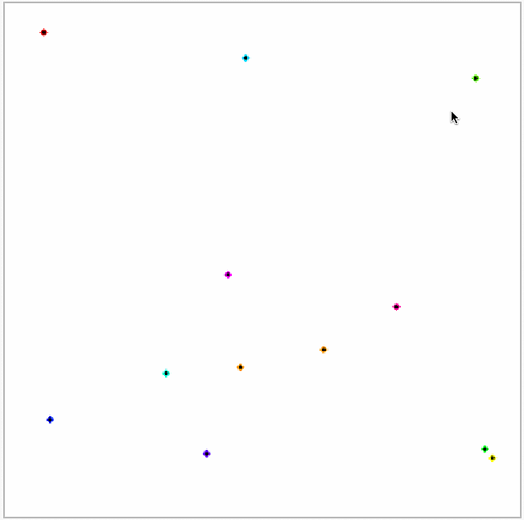
Path generation using Voronoi Cell
Voronoi diagram is for dividing a range having a finite number of obstacles into a number of sub-ranges that each having only one point data while making all subregions closest as much as possible one another.
Path planning using this is to find an optimized path via the graph search algorithm from the Voronoi edges.
Not appropriate to apply this to point cloud directly which is obtained from real laser scanners so modified algorithm is proposed.

Slide 11
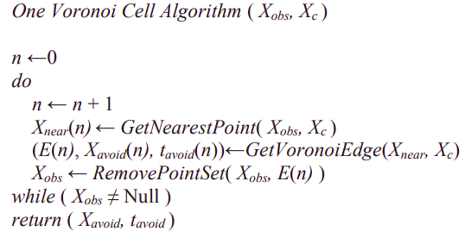
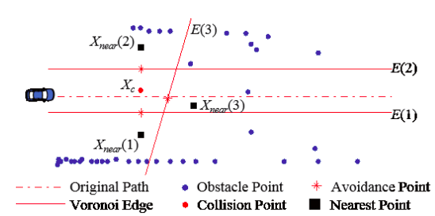
Voronoi Cell Algorithm for collision detection
Once obtaining Xavoid and tavoid, in a voronoi edge, repeat the algorithm after removing sub-elements of Xobs which are located outside of the edge until Xobs is not null.
It searches the maximum clearance against obstacles according to the definition of the Voronoi Diagram so that it provides avoidance path of complex obstacles environment stably.
Furthermore, it can increase efficiency of a path by limiting the size of a cell to prevent a long detour due to a long gap between obstacle points.
An avoidance point is the midpoint between a nearest point.
(Xnear closest to a collision point from obstacle point set, Xobs) and Xc.
tavoid is a slope of a voronoi edge, E.

Slide 12
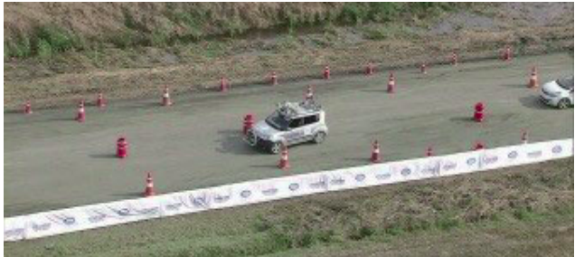
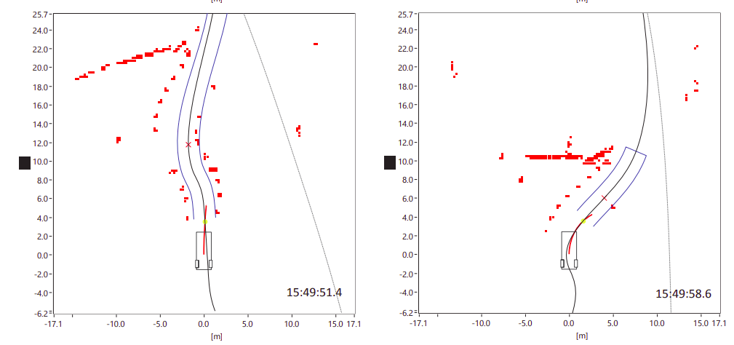
RESULTS
The 2012 Hyundai self-driving competition course is a 3.4km mixed with pave and unpaved roads
The competition consisted of 9 missions like:
  Overtaking slow vehicles
  Unexpected obstacle avoidance
  Sensing of traffic lights in the crossing
  Parking
The proposed Voronoi planning algorithm was able to efficiently pass all the missions.

Slide 13
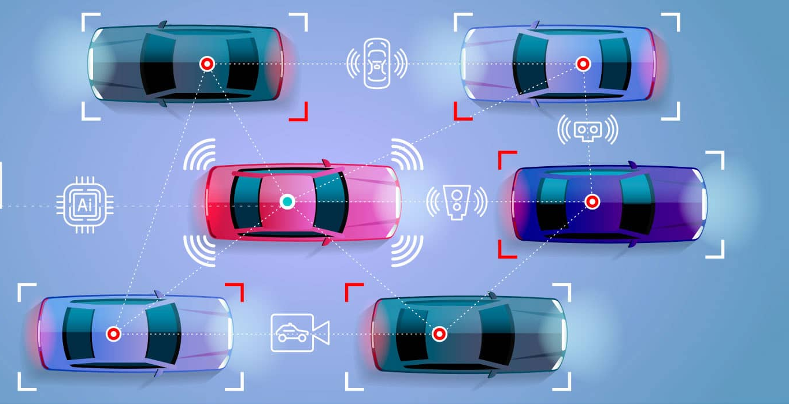
Conclusion
This study presented real-time path modification via the proposed cubic formula and successful avoidances under various obstacle environments via the path generation algorithm.
This study showed that path management using cubic formula was more efficient and path modification was easier than way points.
Continuous detection of collision with obstacles can be possible with path representation using the proposed cubic formula.
Path generation under various obstacle environments can be possible using the one Voronoi cell algorithm and VFH as well as real-time use due to reduction of computation.

Slide 14
THANK YOU

