Slide 1

Graduate Thesis
Multi Robot Coordination
in Unstructured Environment
Guided By
Prof. Dr. Sangram Redkar
Presented By
Cherupally Surya Kiran
ASU ID 1223453127
scherup1@asu.edu
Graduate Committee
Sangram Redkar (Chair) Kevin Nichols Susheel Kumar Cherangara

Slide 2
{
Introduction
UGV Navigation
  Ros & Its Components
  State Estimation
  Navigation
  Results
UAV Control and Swarming
  Comparison
  AI Capabilities
  Swarming
  UI for trajectory planning
UGV - UAV Coordination
  Process Overview
  System Build
  Test Cases
  Conclusion
OUTLINE

Slide 3

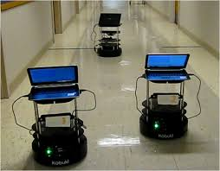
Introduction
Robots are used for operations and working conditions across all industries.
Technological advances are redefining disaster assistance, SAR, and salvage operations.
For Space building and disaster relief we will need collaborating robotics.
There are several constraints involved like cost, power and size that help in mobility and other capabilities.
To optimize a collaboration is the team performance, that helps giving more accuracy and certainty.
Analysis of these collaborative robots. Unmanned Aerial Vehicle {UAV) and Unmanned Ground Vehicle (UGV).
Fig 1 : Multi robot coordination
Notes:
Reference : Fig1 https://www.researchgate.net/figure/Three-Turtlebot-2-robots-used-as-evaluation-platforms-for-the-multi-robot-coordination_fig1_343256195

Slide 4
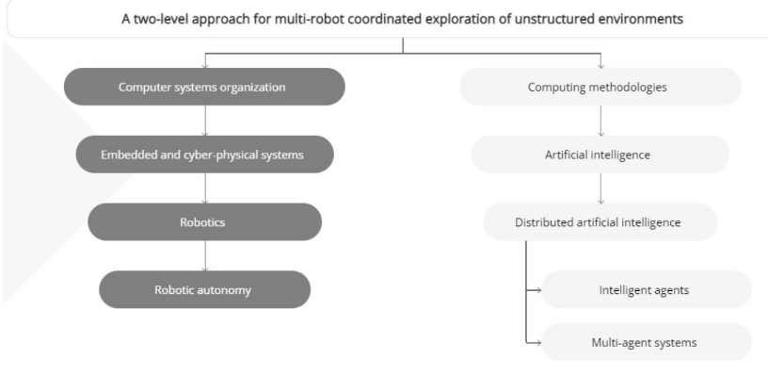
Contd …
Compared to a single robot system, implementing a robot system is not without its challenges.
There are few tasks like coordination and dynamics that are challenging to implement.
Efficiency of a multi robot increases when balance among the robots in their respective environments, either structured or unstructured.
Coordination in robots comes with centralized and decentralized designs.
Fig 2 : A two-level approach Tree for Multi Robot Coordination

Slide 5
Contd …
Localization plays an important role in robot’s navigation for establishing the position and orientation in realistic environments.
Providing accurate and consistent posture estimates is possible by combining several sensors.
The architecture a collection of decentralized control,planning, and AI algorithms, along with behavioural changes and sequential composition of modes.
Challenging environments make it difficult for mobility and capabilities due to cost, power and size restrictions.
For autonomous operation a single camera as a sensor and omni-directional 2D LIDAR is used.

Slide 6
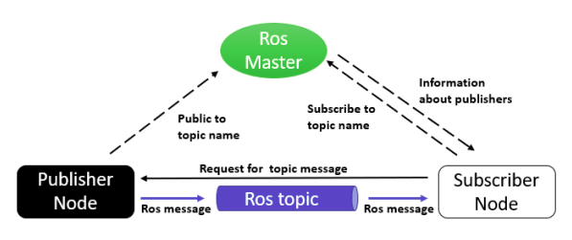
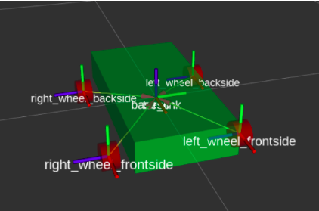
ROS & URDF
ROS was in charge of organizing various tools to be utilized in bringing resources together for the code.
The nodes, referred as a process in ROS interact with one another by exchanging messages as topics.
A ROS Subscriber “subscribes” to a topics to receive message that are broadcast for a subject.
ROS launch file is to control variety of different nodes.
URDF is utilized to define the mechanical features of a robot, the sensors, surroundings and number of other aspects.
The URDF file can be exported directly from solidworks.
Fig 3 : Example of Communication in ROS
Fig 4 : Example Robot using URDF.
Notes:
Reference : Fig 3 https://trojrobert.github.io/hands-on-introdution-to-robot-operating-system%28ros%29/
Fig 4 https://ubuntu.com/blog/the-state-of-robotics-november-2021

Slide 7
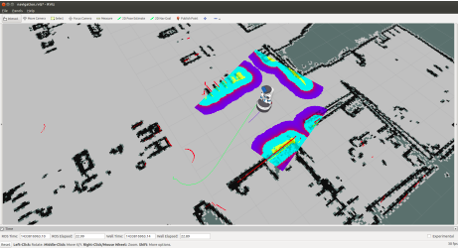
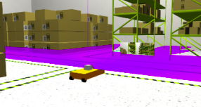
RVIZ & Gazebo
ROS visualization is a software to view data in three dimension.
It helps investigate the robot model, record sensor information, playback the information captured from sensors.
The information is given via webcams, RGB cameras, and 2D laser rangefinders.
Gazebo is a platform for free and open-source high quality robot simulator.
It incorporates a physics simulation, sensors, and interfaces for people and programs.
There are additional hazards linked with the spread of code.
Fig 5 : Example of RVIZ Map
Fig 6 : Gazebo World Example.
Notes:
Reference : Fig 5 https://link.springer.com/chapter/10.1007/978-981-16-4222-7_53

Slide 8
Localization
The navigational tasks can be carried out determining the posture in relation with the environment. There are two different localization techniques are:
1. Map-based Localization - Here the surroundings are known in advance owing to the map.
2. Simultaneous Localization - The mobile robot’s position and immediate surroundings are unknown.
When identifying the localization problems the focused areas are as below :
1.Previous knowledge about the starting point.
2.The kind of environment.
3.The type of approach.
4.Total number of localizing robots.
When the UGV is doing its operational functions there are two localizations that apply to this categorization called local and global.

Slide 9
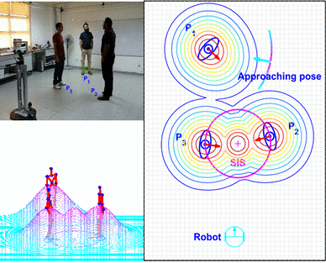
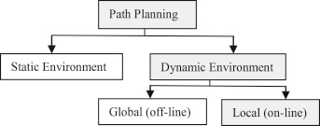
Types of environment
Another factor, Localization has a relation is the characteristics of the neighbourhood that surrounds it.
A Static Environment is the robot’s placement inside a sole variable that cannot be recreated in the actual world..
A dynamic Environment is more accurate representation of the actual site of an event. Objects include any moving thing in the same environment as the robot, such as a group of people.
Fig 7 : Autonomous robot path planning according to the environment.
Fig 8 : Dynamic environment for mobile based robot.
Notes:
Reference: Fig 7 https://www.sciencedirect.com/science/article/pii/S0921889014001274-
Fig 8 https://link.springer.com/article/10.1007/s12369-016-0352-0

Slide 10
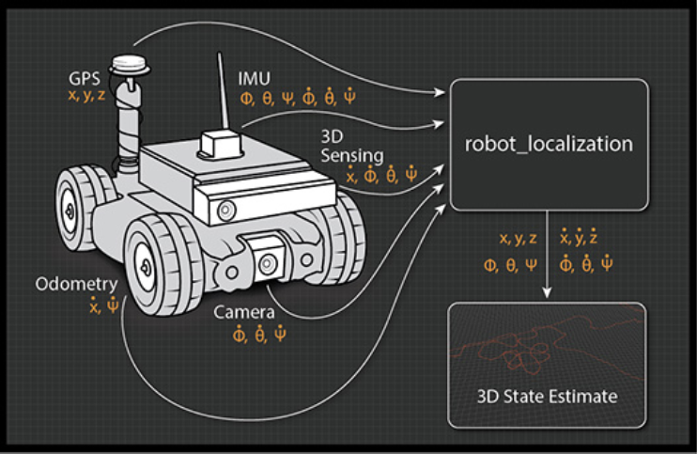
State Estimation
The purpose of state estimation is to derive state variables from the available data.
Challenges with Sensors:
Sensors cannot directly quantify the state variables of robots - as sensor inputs can only communicate a piece of the information
Additionally, there is a possibility of noise in the measurements that are provided by the sensors
Thus, state estimation tackles the challenge of estimating values from sensor data that are not immediately visible but that may be inferred,
Fig 9 : State Estimation for robot localization
Notes:
Reference : Fig9 http://docs.ros.org/en/api/robot_localization/html/index.html

Slide 11
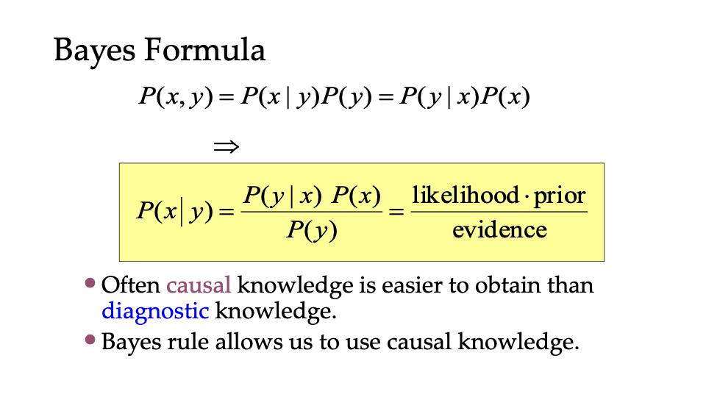
Bayes Filter

Slide 12


Bayes Filter: Framework
Given:
  Stream of observations z and action data u:
  Sensor model P(z|x)
  Action model P(x|u,x’).
  Prior probability of the system state P(x).
Wanted:
  Estimate of the state X of a dynamical system.
  The posterior of the state is also called Belief:

Slide 13
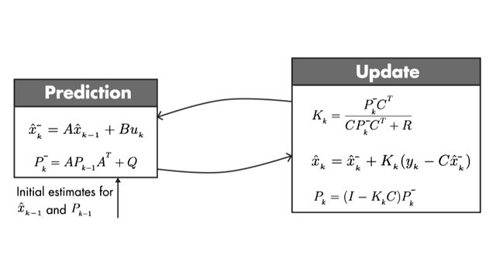
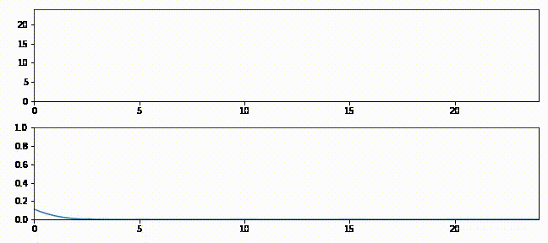
Kalman Filter: Framework
What is a Kalman Filter:
• A Kalman filter is an optimal estimator – i.e. infers
parameters of interest from indirect, inaccurate and
uncertain observations. It is recursive so that new
measurements can be processed.
Optimal in what sense:
If Noise is Gaussian: the Kalman filter minimizes the mean square error of the estimated parameters.
If Noise is NOT Gaussian: Kalman filter is still the best linear estimator. Nonlinear estimators may be better.
Fig 10.1: Optimal State Estimation Algorithm
Fig 10.2: Example of Kalman Filter Process
Notes:
Reference : Fig 10 https://www.youtube.com/watch?v=VFXf1lIZ3p8

Slide 14
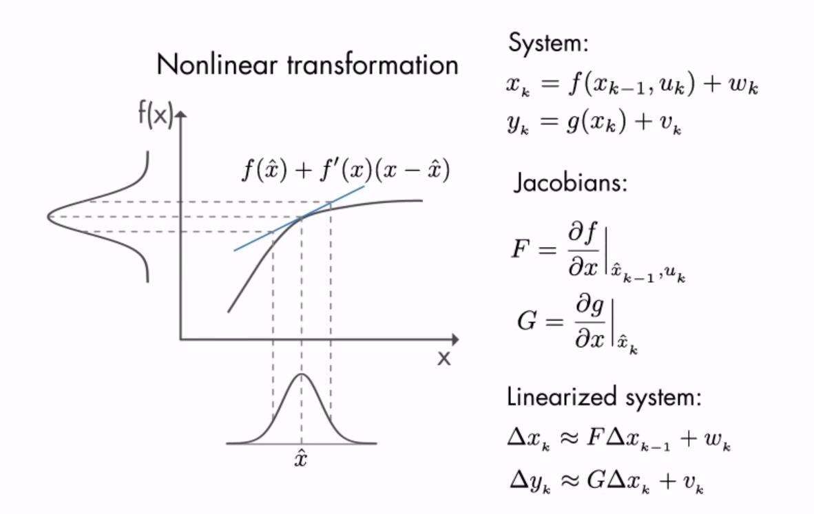
Extended Kalman Filter
The extended Kalman filter (EKF) in estimating theory is a nonlinear variation of the Kalman filter that linearizes around an estimate of the current mean and covariance.
Fig 11 : Kalman Filter estimation theory

Slide 15
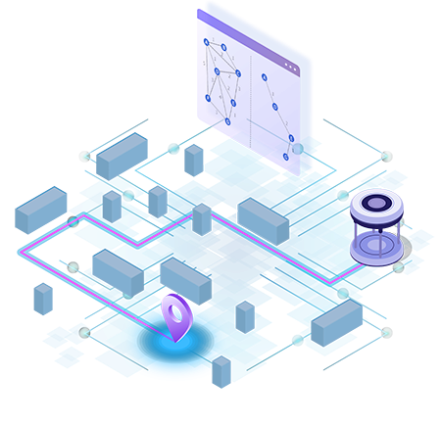
Path Planning
The goal of mobile robot path planning is to find a path from the current position to the target position.
The path should be as short as possible, the smoothness of the path should meet the dynamics of the mobile robot, and the safety of the path should be collision-free
Fig 12 : Path planning estimation map

Slide 16
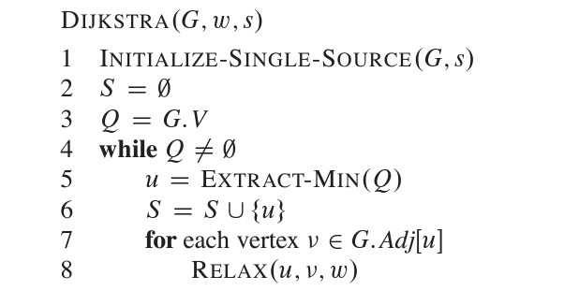
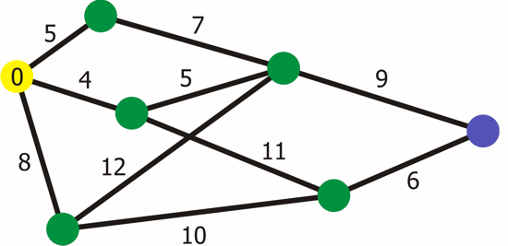
Dijkstra Path Planning Algorithm
Dijkstra's algorithm - is a solution to the single-source shortest path problem in graph theory.
Dijkstra’s approach identifies the path that minimizes the total distance (weight) between the source node and all other nodes by using edge weights.
In general, it works on the relaxation principle, which states that an estimate of the precise distance is gradually displaced by more suitable values until the shortest distance is attained.
Fig 13.1 : Dijkstra - Pseudo Algorithm
Fig 13.2 : Dijkstra - Working

Slide 17
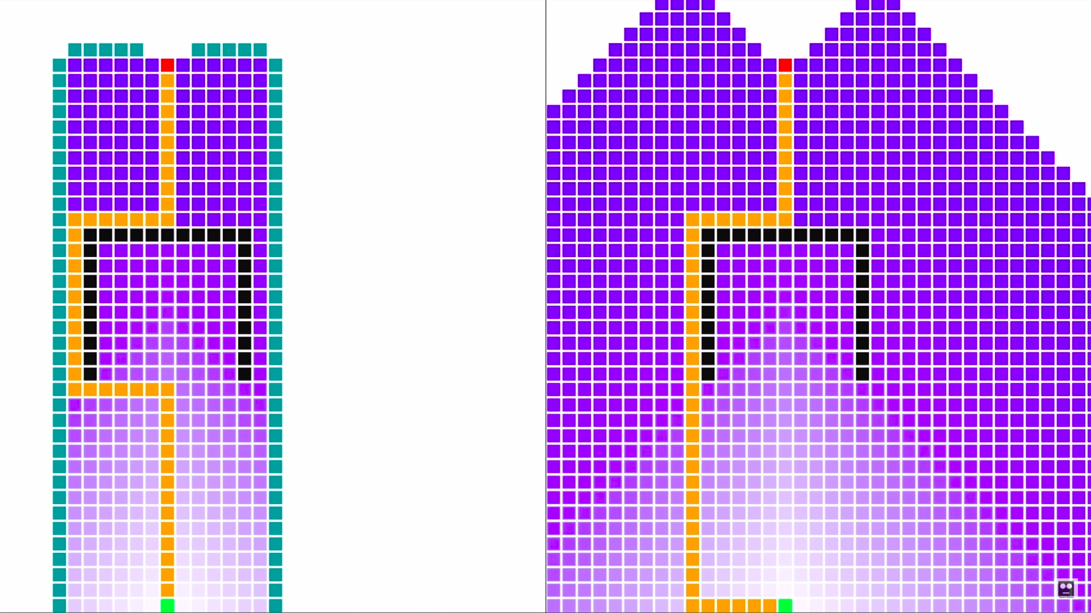
A* Path Planning Algorithm
A* is a Dijkstra’s algorithm extension that supports breadth-first search (BFS)
A* combines features of uniform-cost search and pure heuristic search to effective compute optimal solutions
The effective cost is
f(n) = g(n) + h(n)
Where
g(n) = Path cost from start node to node n
h(n) = Heuristic Cost
Fig 14 : A* vs Dijkstra

Slide 18
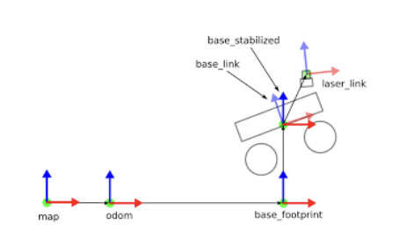
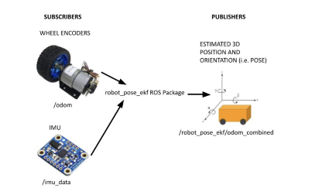
Robot Simulation
Transformations
Sensor Fusion Package
Fig 15.2 : Flow of Sensor Fusion Package
Fig 15.1 : Example of Robot with Different Coordinate Frames
Notes:
Reference : Fig 15.1 http://library.isr.ist.utl.pt/docs/roswiki/hector_slam%282f%29Tutorials%282f%29SettingUpForYourRobot.html
Fig 15.2 https://automaticaddison.com/sensor-fusion-using-the-ros-robot-pose-ekf-package/

Slide 19
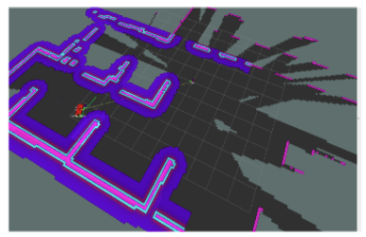
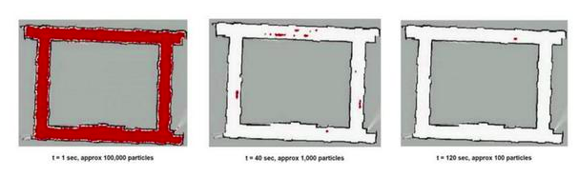
Localization & Mapping
Localization
Employed AMCL package
Mapping:
Used ROS Gmapping Package
Fig 16.1 : Visualization of Generated Occupancy Grid Using RVIZ
Fig 16.2: Example of AMCL

Slide 20
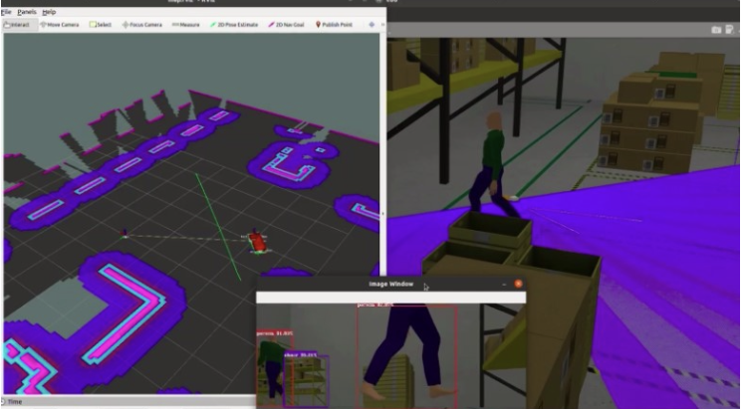
Rviz is used to specify the pose and where the robot has to move in the generated SLAM map
We used the ROS Navigation stack to generate paths for the robot
Used YOLO V4 pre-trained on COCO dataset for object detection
Simulation Results
Fig 17 : Navigation and Object detection of UGV

Slide 21
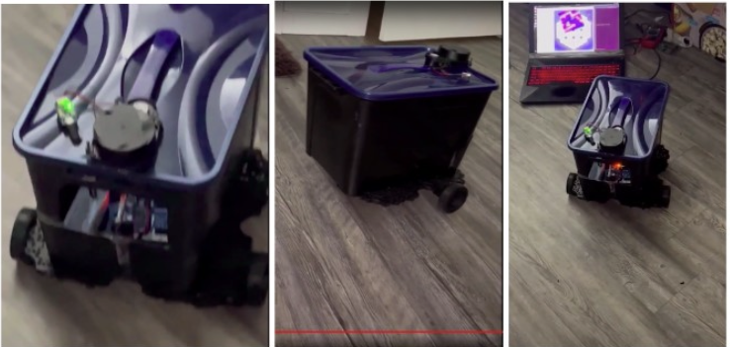
Prototype - Hardware
Chassis from a storage container
Raspberry PI 4B
Arduino Mega
Motor drivers - L298N
12V DC Motor 110 RPM
LIDAR - RPLIDAR A1
Camera - Logitech C720
UltraSonic Sensors - 4
Fig 18 : UGV Robot
Notes:
Reference : Fig 18 was made personally

Slide 22
UAV Flying and Swarming In Unstructured Environment
UAV swarm is a disruptive technology;
They may coordinate multiple UAVs without human participation
This thesis reviews UAV swarm literature and offers a swarm architecture that uses wireless communication to increase autonomy and dependability
This thesis employs Tello EDU drone
The project will concentrate on both solo and swarm programming
Individual applications were built first, then for the swarm
Pretrained models and APIS given by MediaPipe facilitates transformation of standard drone into an autonomous aerial vehicle

Slide 23
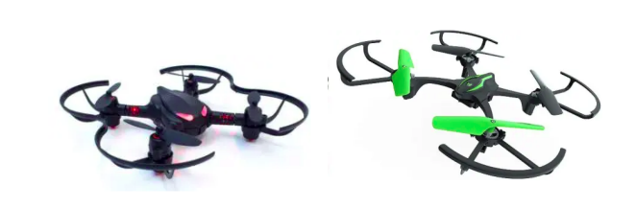
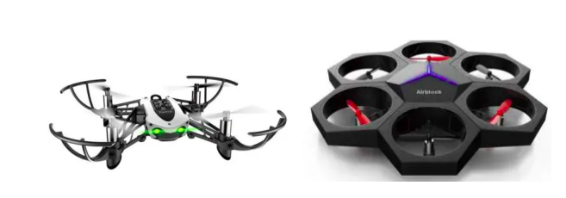
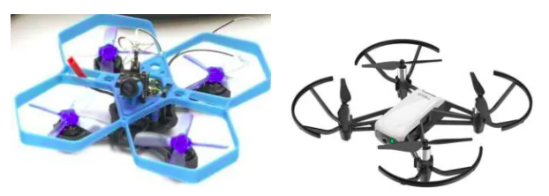
Comparative Study of Educational Drones
Dronezon has researched, evaluated, and rated the seven best drones currently available on the market
Robolink CoDrone Lite
Sky Viper e1700
Parrot Mambo Fly Educational
Makeblock Airblock Educational Drone
3D Printed Mini Drone
DJI Tello Edu
Fig 19 : Different kinds of Drones

Slide 24
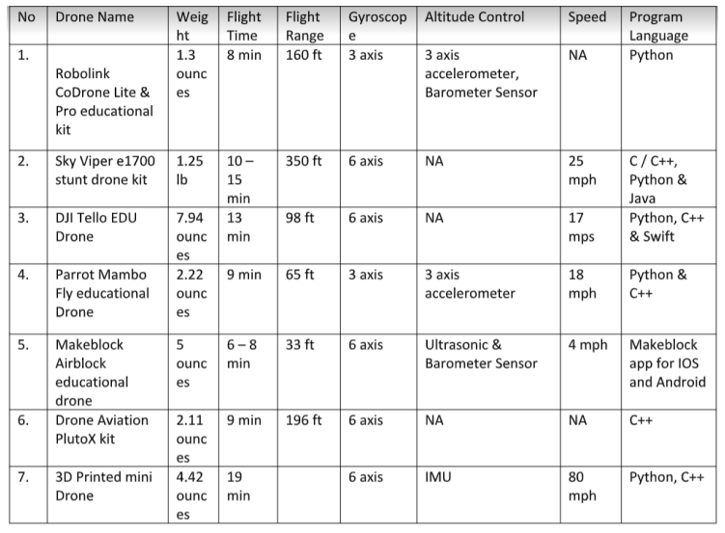
Comparison of Drones
Table 1 : Comparison between different kinds of Drones

Slide 25
Contd
A detailed comparison table has been presented in the previous slide which takes into account the key features like weight, flight-time, height, gyroscope, speed and supported programming languages
While most offer equivalent features such as block programming and a decent battery, Tello EDU’s potential for teaching is enormous
Its simplicity of programming has resulted in a plethora of applications
DroneBlocks allows for simple programming using blocks
It has one of the best documented Python API for developers.Latest API supports swarming, technically for countless number of drones
Owing to the many benefits of Tello, my thesis employs two Tello drones to demonstrate autonomous drone and swarming capabilities

Slide 26
Tello Drone with AI capabilities
Decentralized architectures facilitates individual robots to make their own decisions and communicate their actions to other robots
Search and rescue missions require each robot to grasp the circumstance and work together to effectively rescue people
Giving AI capabilities to drones allows them to better comprehend the situation
It aids in closing the communication gap between people and robots for more effective rescue operations
AI plays a crucial role in SAR operations, as a person cannot observe multiple video feedbacks from each drone for 24 hours,

Slide 27
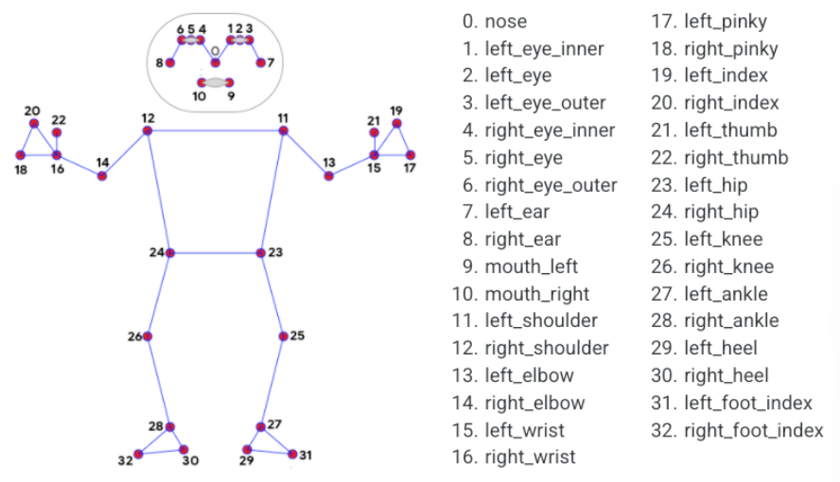
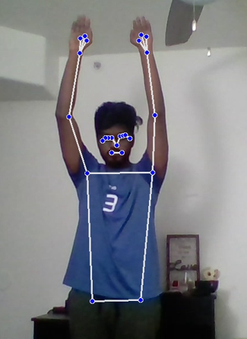
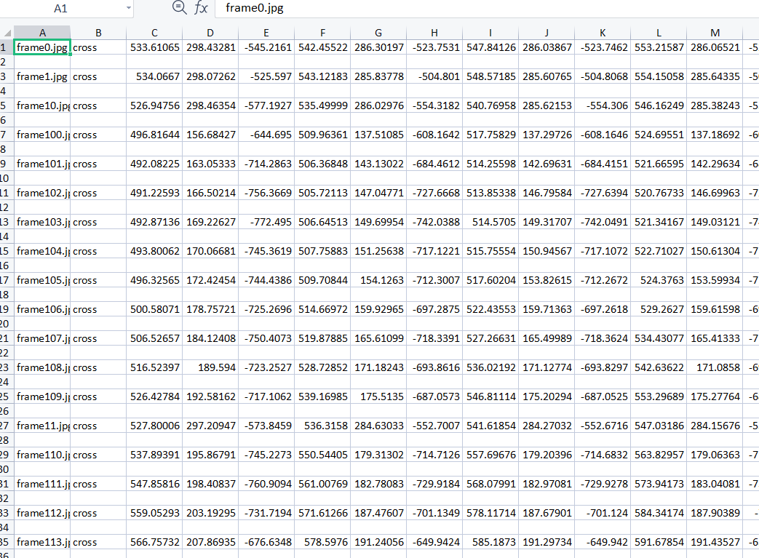
Controlling Drone with Body Postures
The ability to perceive the shape and motion of hands can form the basis for sign language understanding and hand gesture control.
MediaPipe Pose two-step detector-tracker ML pipeline has been implemented to detect 33 3D landmarks.
Dataset has been created by running pose detection for different poses.
Train_X = N * [(x0,y0) , (x1,y1) …… (x32,y32)]
Train_Y = N*label for each pose
KNN algorithm has been trained to recognize pose when given landmarks.
Fig 20.2 : Key points for Body posture detection and stats.
Input
Frame
33 3d landmarks detection
Pass landmarks to KNN model and recognize gesture
Control Drone based on gesture
Fig 20.1 : Flowchart explaining Control of Drone with Body postures
Notes:
https://google.github.io/mediapipe/solutions/pose.html

Slide 28
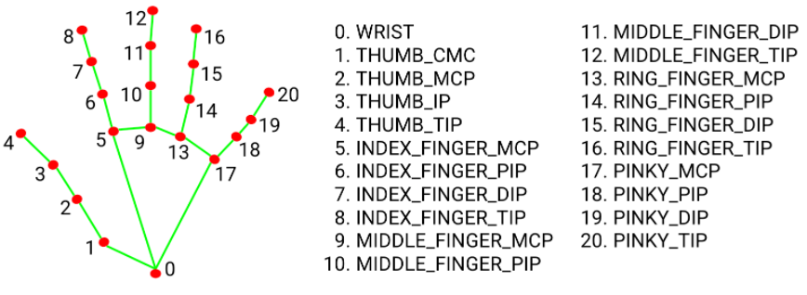

Controlling Drone with Hand Gestures
Human pose estimation from video plays a critical role in various applications such as sign language recognition, and full-body gesture control.
MediaPipe Hands has been implemented to detect 21 3D landmarks .
2 stage detection:
    A palm detection - returns an oriented hand bounding box.
    A hand landmark model - returns high-fidelity 3D hand keypoints
Dataset has been created by running hand gesture detection for different gestures.
Train_X = N * [(x0,y0) , (x1,y1) …… (x20,y20)]
Train_Y = N*label for each hand gesture
KNN algorithm has been trained to recognize pose when given landmarks.
Fig 21.2 Hand gesture key points and training.
Input
Frame
21 3d landmarks detection
Pass landmarks to KNN model and recognize gesture
Control Drone based on gesture
Fig 21.1: Flowchart explaining the control of Drone with Hand Gestures.
Notes:
https://google.github.io/mediapipe/solutions/hands.html

Slide 29
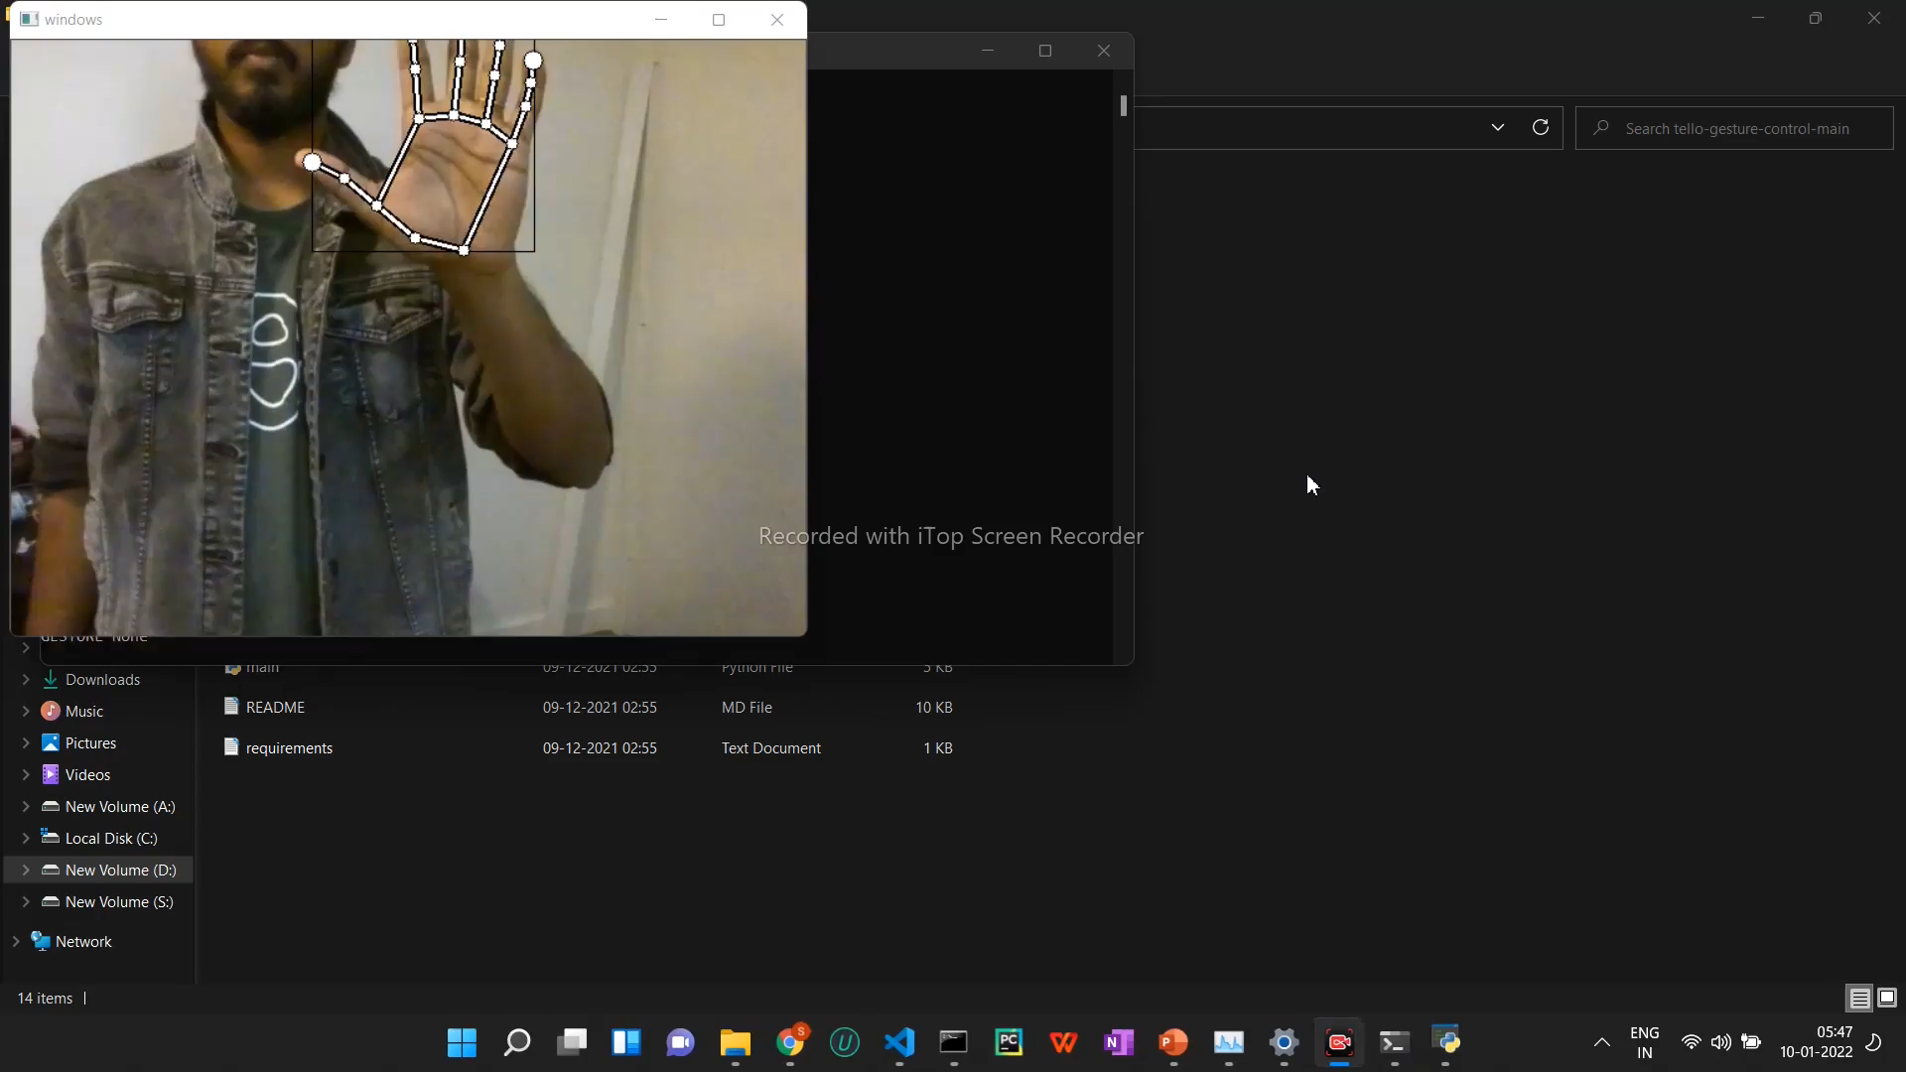
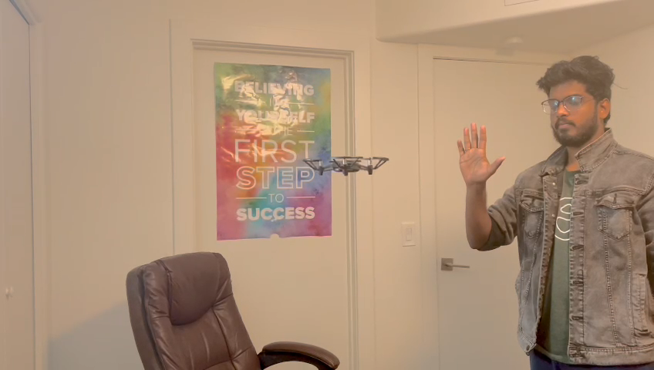
DEMO
Fig 22 : Drones Detecting and moving according to the Hand Gestures.

Slide 30
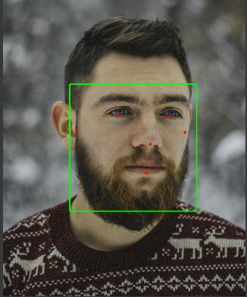
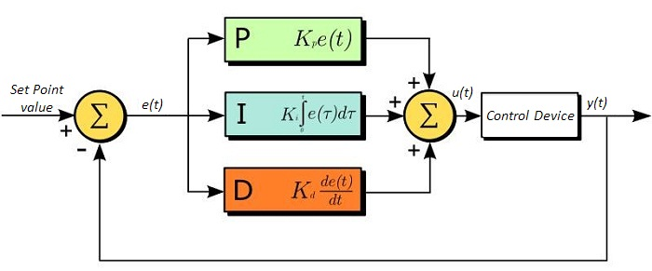
Face Detection and autonomous tracking using Tello
The drone will be able to identify faces in the captured footage in real time and then follows the user autonomously to keep the person in the video frame.
2 steps :
1)Face detection
2) Follow the face
For face detection MediaPipe’s Face Detection which is an ultrafast face detection solution is used. It comes with 6 landmarks and multi-face support
Making Tello follow face means the face would always be in the center of the frame.
Movement/Speed of Tello is calculated using proportional-integral-derivative(PID) controller, vector that is multiplied by the movement and helps control the speed of the drone.
Input
Frame
Detect Face
Calculate Movement using PID
Control Drone
Fig 23 : Architecture and flow chart for Face detection.
Notes:
A proportional–integral–derivative controller (PID controller or three-term controller) is a control loop mechanism employing feedback that is widely used in industrial control systems and a variety of other applications requiring continuously modulated control. A PID controller continuously calculates an error value {\displaystyle e(t)}e(t) as the difference between a desired setpoint (SP) and a measured process variable (PV) and applies a correction based on proportional, integral, and derivative terms (denoted P, I, and D respectively), hence the name
https://en.wikipedia.org/wiki/PID_controller
https://google.github.io/mediapipe/solutions/face_detection.html

Slide 31
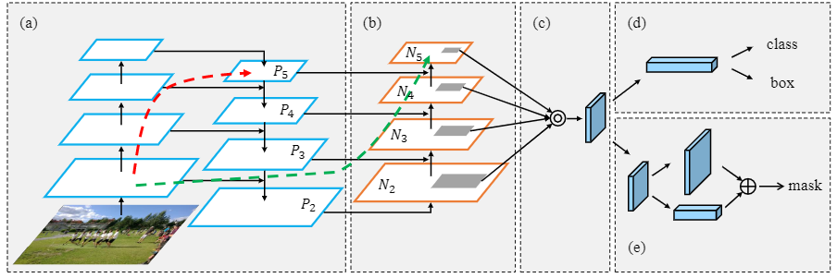
Object Detection
The drone will be able to identify different objects in the captured footage in real time and then perform actions based on the detected object
For object detection YOLOv4 which is an evolution of the YOLOv3 model is implemented.
It is based on a single Convolutional Neural Network (CNN) which divides image into regions and then it predicts the boundary boxes and probabilities of an object for each region.
Input
Frame
YOLOV4
Object Detection
Perform actions on Drone based on object
Fig 24 : Architecture and flow chart for Object Detection.
Notes:
A proportional–integral–derivative controller (PID controller or three-term controller) is a control loop mechanism employing feedback that is widely used in industrial control systems and a variety of other applications requiring continuously modulated control. A PID controller continuously calculates an error value {\displaystyle e(t)}e(t) as the difference between a desired setpoint (SP) and a measured process variable (PV) and applies a correction based on proportional, integral, and derivative terms (denoted P, I, and D respectively), hence the name
https://en.wikipedia.org/wiki/PID_controller
https://google.github.io/mediapipe/solutions/face_detection.html

Slide 32
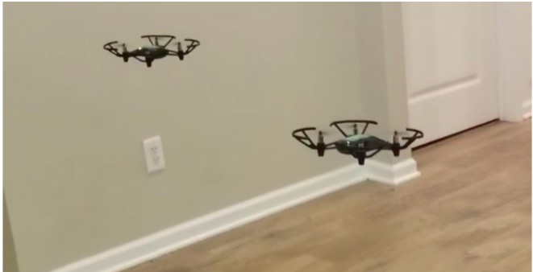
Swarm Drones
Multiple different robotic systems that carry out collective behavior interactions between them
Tello Edu is a low-cost drones with an Open API
Program additional Tellos join the same WiFi network for swarm
Image recognition built in for a set of Mission Pads, allowing for better location accuracy and search activities.
Use a WIFI Access Point to connect to several drones, as well as support for Mission Pads and synchronized
Utilize Python modules such as netifaces and netaddr.
Fig 25 : Swarm Drones

Slide 33
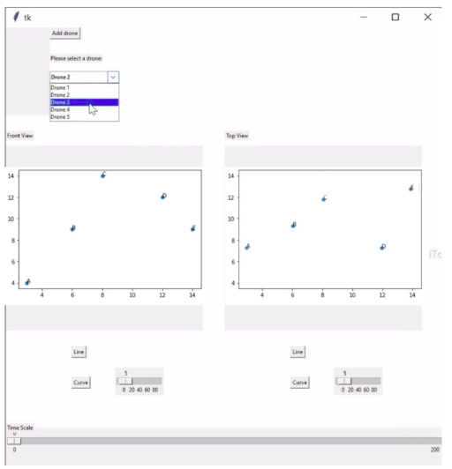
UI for Multi Drone Trajectory Planning
UI component for adding trajectories for each individual drone
LPV-MPC controller for a drone mathematical model.
Multi drone trajectory planning is designed using the 3D mathematical model
Add the trajectory for that drone using the XY and YZ axis plotters
Follow the course with regard to time.
Line interpolation or curve interpolation.
2D planes instead of a single 3D space reduces path complexity and enables more precise placement.
Fig 26: UI component for adding trajectories

Slide 34
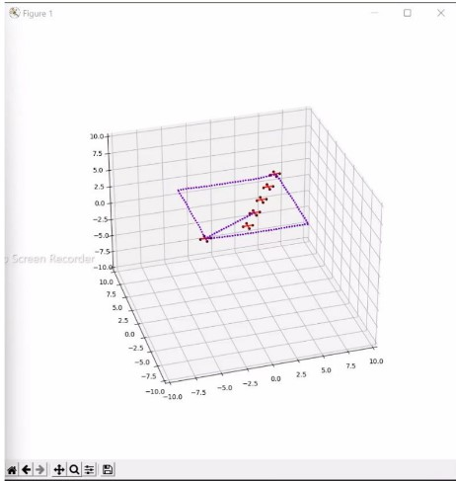
UI for Multi Drone Trajectory Planning Contd..
UI for visualizing multiple drone trajectories at same time
View animation of drones following their different paths after creating trajectories for each drone.
UI allows for a better knowledge of each drone’s trajectory and a collision-free aerial navigation system
Proper trajectory design also aids in effectively covering larger regions by eliminating overlapping trajectories.
Validated that our Tello drones had collision-free paths using this multi-drone trajectory planner.
Fig 27: Multi Robot Trajectory Planning

Slide 35
COLLABORATIVE UAV AND UGV
Robots are often regarded as very effective machines for SAR operations
UGVS:
Pros: Able to carry a bigger battery, better hardware
Cons: Getting stuck and not being able to map the environment entirely
UAVS:
Pros: Able to fly over high regions and blocked spaces
Cons: Limited hardware and battery life
Coordination and Cooperation between robots is best approach for such situations

Slide 36
COLLABORATIVE UAV AND UGV
Robots are often regarded as very effective machines for SAR operations
UGVS:
Pros: Able to carry a bigger battery, better hardware
Cons: Getting stuck and not being able to map the environment entirely
UAVS:
Pros: Able to fly over high regions and blocked spaces
Cons: Limited hardware and battery life
Coordination and Cooperation between robots is best approach for such situations

Slide 37
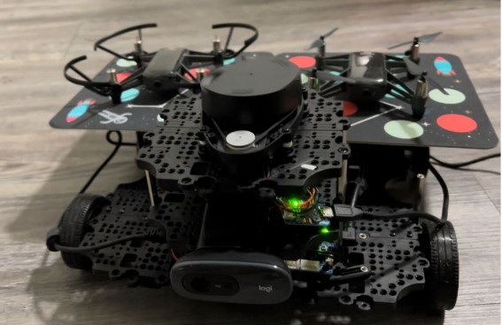
Overview of Multi-Robot System
Redesigned the chassis of the Turtlebot3 robot to accommodate drones.
OPENCR board which uses 32-bit ARM Cortex M7 processor.
Onboard TTL ports, SMPS source ports and 9-axis IMU (MPU 9250)
Dynamixel Motors are used instead of DC motors with encoders for precise wheel rotations count and higher torque capacity.
Novel robot UGV design and configuration with a 3-floor structure.
Reused both the 2D Lidar and camera.
Used same navigation stack and added AI algorithms.
Decentralized System Control Process.
Fig 28 : Multi Robot System with Drones.

Slide 38
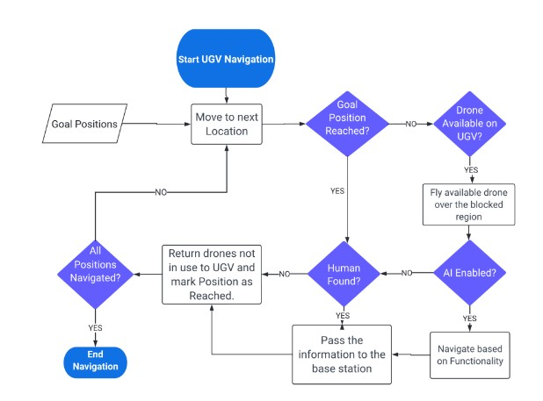
Overview of Process
Fig 29 : Flow Chart Explaining the Process of Navigation

Slide 39
Overview of Process
Whole process divided into 6 states, with few behavior checks at each stage.
State zero, Robot at rest, continuously checking for input goal positions feed.
State one, sequence of objective positions are passed manually where we suspect human presence.
State two, the land robot sorts locations depending on their distance and navigates progressively to each destination.
Once the mobile robot reaches the goal position, we then proceed to state three, Human Detection.
If the robot is not able to reach goal position, we move into state four from state two.
State four, we instruct one of the available drones to hover on top of the blocked location and move back to state two to navigate to the next objective location.
If there are no available drones we add the current goal location to the queue, move back to state two for next objective locations.

Slide 40
Overview of Process Contd …
State four, we have a drone hovering on top of the blocked location. We check if we have enabled AI (Gesture Control, Face Tracking etc).
If AI is enabled we move to state five and six which used AI to navigate the drone based on the scenario and pass that information the base station for any immediate actions. If AI is not enabled we move to state three which is human detection.
If we detect human in the goal location through any of the source (UAV/UGV) we pass that information to the base station and continue to the next goal position.
If the drone detected human, we return that drone back to the land robot. If there are any unexplored goal locations in the queue, we order the drone to hover on them and moving into state four.
Once we navigate through all the goal positions, we then return back to state zero, and continuously check for incoming positions data to move into state One.

Slide 41
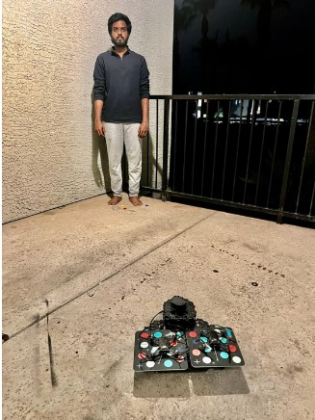
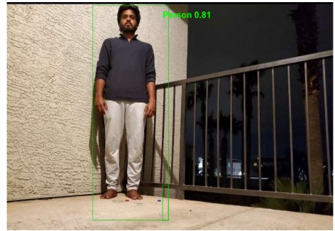
Test Results
System without Blockage
Passed the goal positions in form of tuple
Base robot successfully navigated through environment avoiding obstacles and reached goal position.
Robot performed human detection using YOLOv4
Information passed back to the hub and was saved in Text File.
Fig 30 : Multi Robot Detection when there is no Obstacle

Slide 42
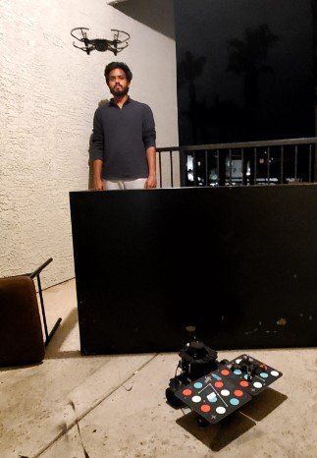
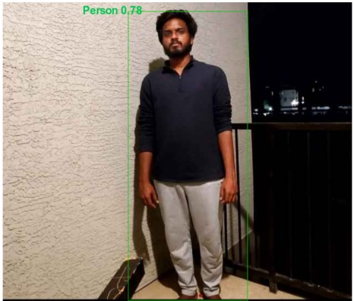
Test Results
System with Blockage
Passed the goal positions in form of tuple
Base robot could not reach the goal position because of blockage.
Instructed available drone to fly over the blocked region and take a circle
Drone performed human detection using YOLOv4
Information passed back to the hub and was saved in Text File.
Fig 31 : Multi Robot Detection when there is an Obstacle.

Slide 43
Conclusion and Future Scope
UGV and UAV multi-robot coordination presented is adaptable to many multi-robot system problems.
There is a lot of community support for ROS and python technologies.
There are several opportunities for enhancement, some of which are listed here.
  It is feasible to train a robust robot using Reinforcement Learning.
  Use socially cooperative policies.
  In contrast to simulation-based systems real datasets must be used
  Consider several sets of route evaluation metrics
  Understand the situation and decision-making processes.
  Developing and testing robots for use in the real world under varied conditions.
  Angular 2D Lidars for enhanced distance estimation of smaller than robot objects.
  Utilize State-Machines to provide robots with unique behaviors based on a variety of situations.

Slide 44
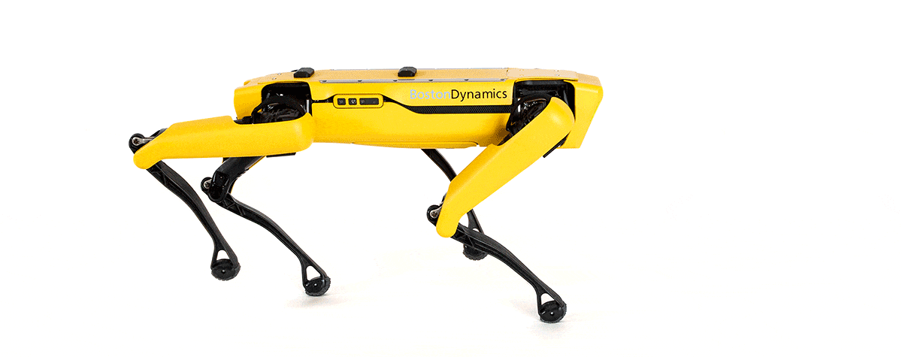
THANK YOU

